Slide 1

Deploy VM with ARM and Custom Images
Training v1.1 (2021-08-16)
CSA / Paul Lizer

Slide 2
Agenda
Objectives
Custom Images vs. Shared Image Gallery
Process to Create VM from Shared Image Gallery
Create VM from Marketplace
Prepping a Virtual Machine to Become an Image
Collect Publisher, Product, Plan Information
Create Shared Image Gallery
Create Storage Account
Create Image Definition
Capture Image
Create Image Version
What is ARM?
What are ARM Templates?
Deploy & Parameter JSON
Infrastructure as Code
Visual Studio Code and ARM
Deploy VM via Portal using Shared Image Gallery
Deploy SIG VM via Portal using ARM Template
Deploy SIG VM via PowerShell using ARM Template
Additional Training
Next Steps

Slide 3
Objectives
Develop a foundational understanding of:
Image Management
ARM Templates
Deploy Custom Virtual Machines
Azure PowerShell and CLI
Infrastructure as Code

Slide 4
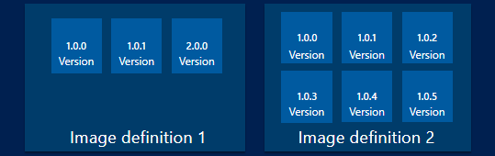
Custom Images vs. Shared Image Gallery (SIG)
Only be used to create VMs in the same region
Require a generalized VM or VHD file
Cannot be shared across subscriptions and tenants.
Managed images could be used for development and test environments, where you need a couple of simple generalized images to use within single region and subscription.
Creating, managing and sharing images at scale
Global replication of images.
Highly available images with Zone Redundant Storage
Sharing across subscriptions, and even between Active Directory (AD) tenants, using Azure RBAC.
Scaling your deployments with image replicas in each region.
Managed Images - Azure Virtual Machines | Microsoft Docs
Share VM images with Shared Galleries - Azure Virtual Machines | Microsoft Docs

Slide 5
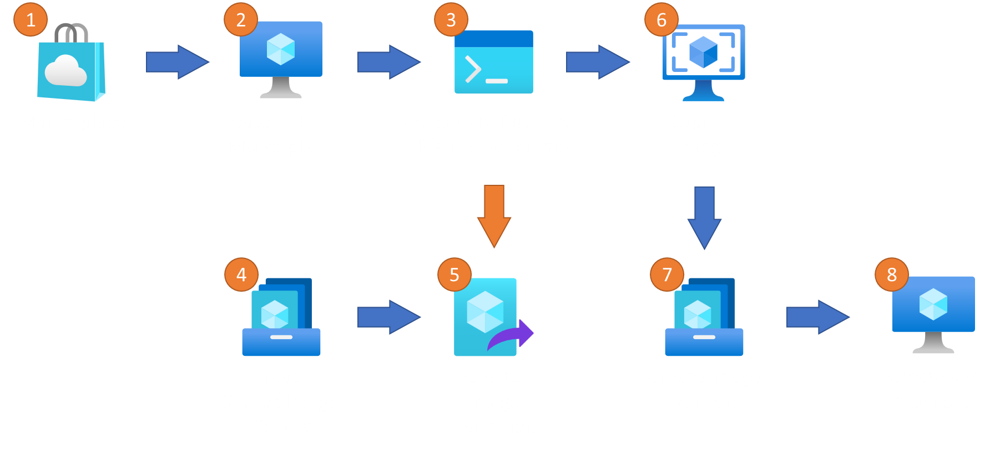

Process to Create VM from Shared Image Gallery
Notes:
Using VMs from the Marketplace
Create Virtual Machine
Using Azure CLI or PowerShell, collect the Publisher, Plan, and Product information to populate SIG Image Definition
Create Shared Image Gallery
Using info collected in Step #3, create Image Definition
Using VM created in Step #2, Capture Image
Add Image created in Step #6 to the SIG and Definition created in Steps #4 & #5
Create VM using SIG Image for organization

Slide 6
Create VM from Marketplace
2
Quickstart - Create a Windows VM in the Azure portal - Azure Virtual Machines | Microsoft Docs

Slide 7
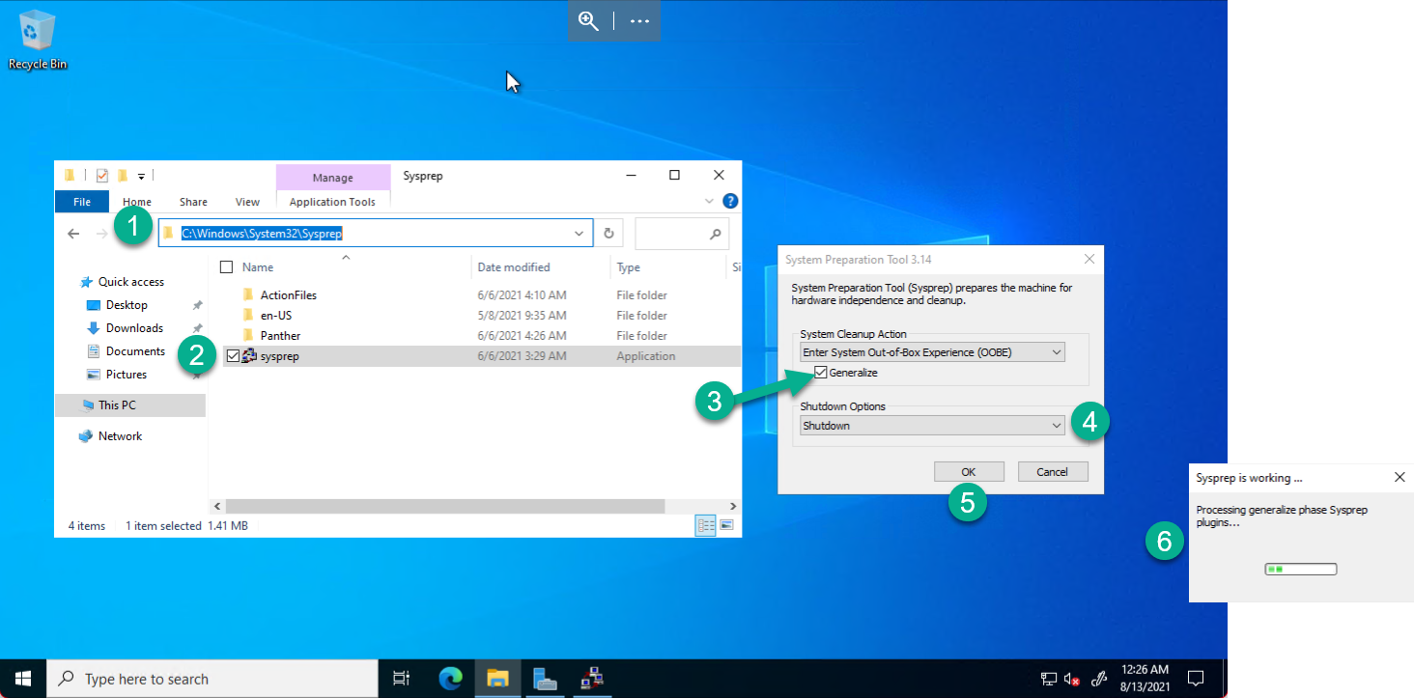
Prepping a Virtual Machine to Become an Image
How to Use Sysprep: An Introduction | Microsoft Docs

Slide 8
Collect Publisher, Plan, Product Information
3
Find and use marketplace purchase plan information using the CLI - Azure Virtual Machines | Microsoft Docs
Find and use marketplace purchase plan information using PowerShell - Azure Virtual Machines | Microsoft Docs

Slide 9
Create Shared Image Gallery
4
Create an Azure Shared Image Gallery using the portal - Azure Virtual Machines | Microsoft Docs

Slide 10
Create Image Definition
5
Create an Image Definition using the portal - Azure Virtual Machines | Microsoft Docs

Slide 11
Capture Image
6
Capture an image of a VM using the portal - Azure Virtual Machines | Microsoft Docs

Slide 12
Create Image Version
7
Create an Image Version using the portal - Azure Virtual Machines | Microsoft Docs

Slide 13
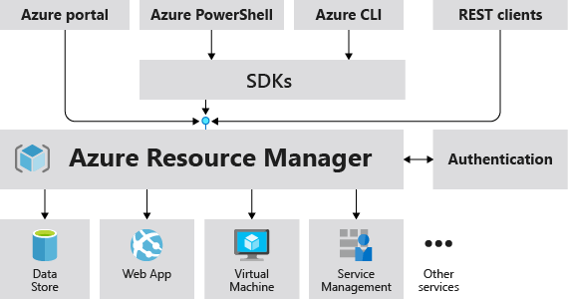
What is ARM?
Azure Resource Manager is the deployment and management service for Azure.
Provides a management layer that enables you to create, update, and delete resources in your Azure account.
PowerShell, Azure CLI, Portal GUI, and SDKs are used to interact with the underlying ARM APIs.
Azure Resource Manager overview - Azure Resource Manager | Microsoft Docs

Slide 14
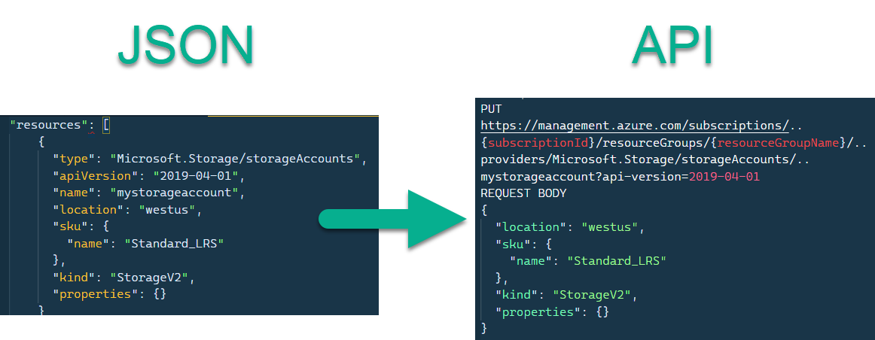
What are ARM templates?
Templates overview - Azure Resource Manager | Microsoft Docs

Slide 15
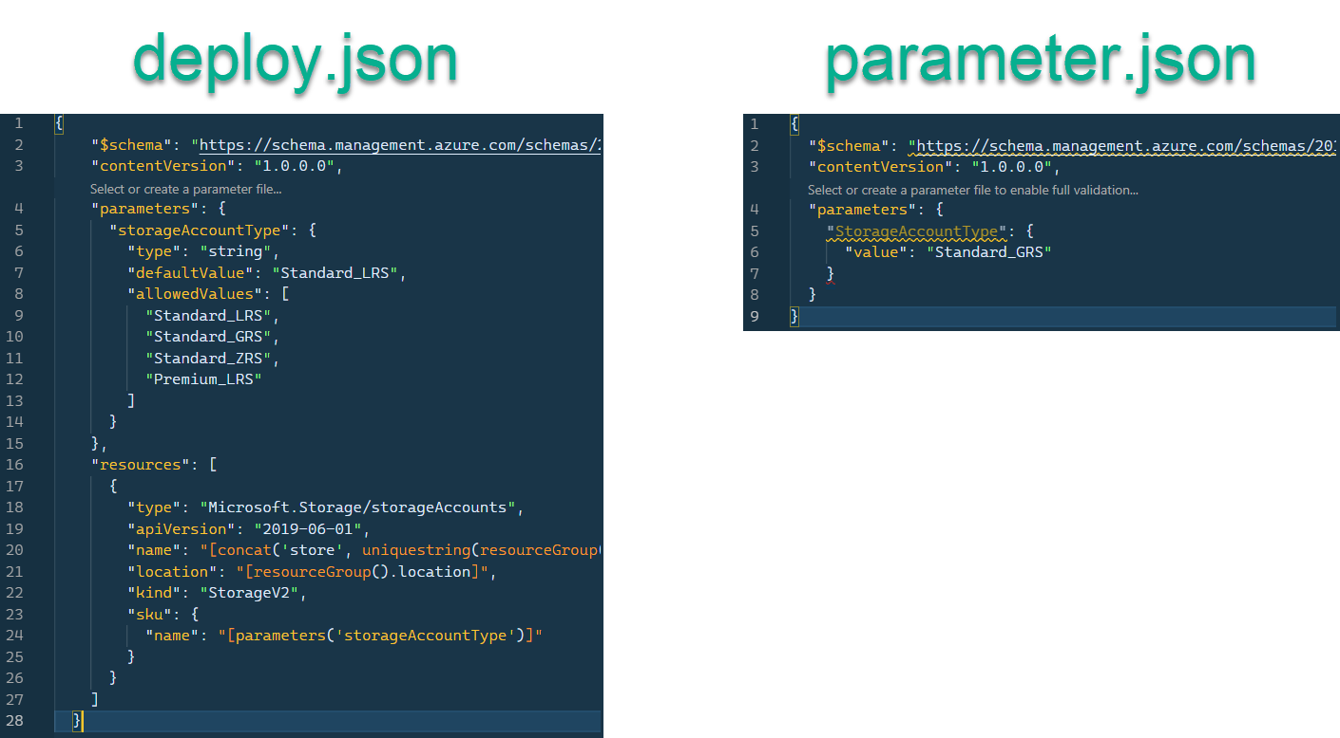
Deploy & Parameter JSON
Create & deploy template specs - Azure Resource Manager | Microsoft Docs

Slide 16

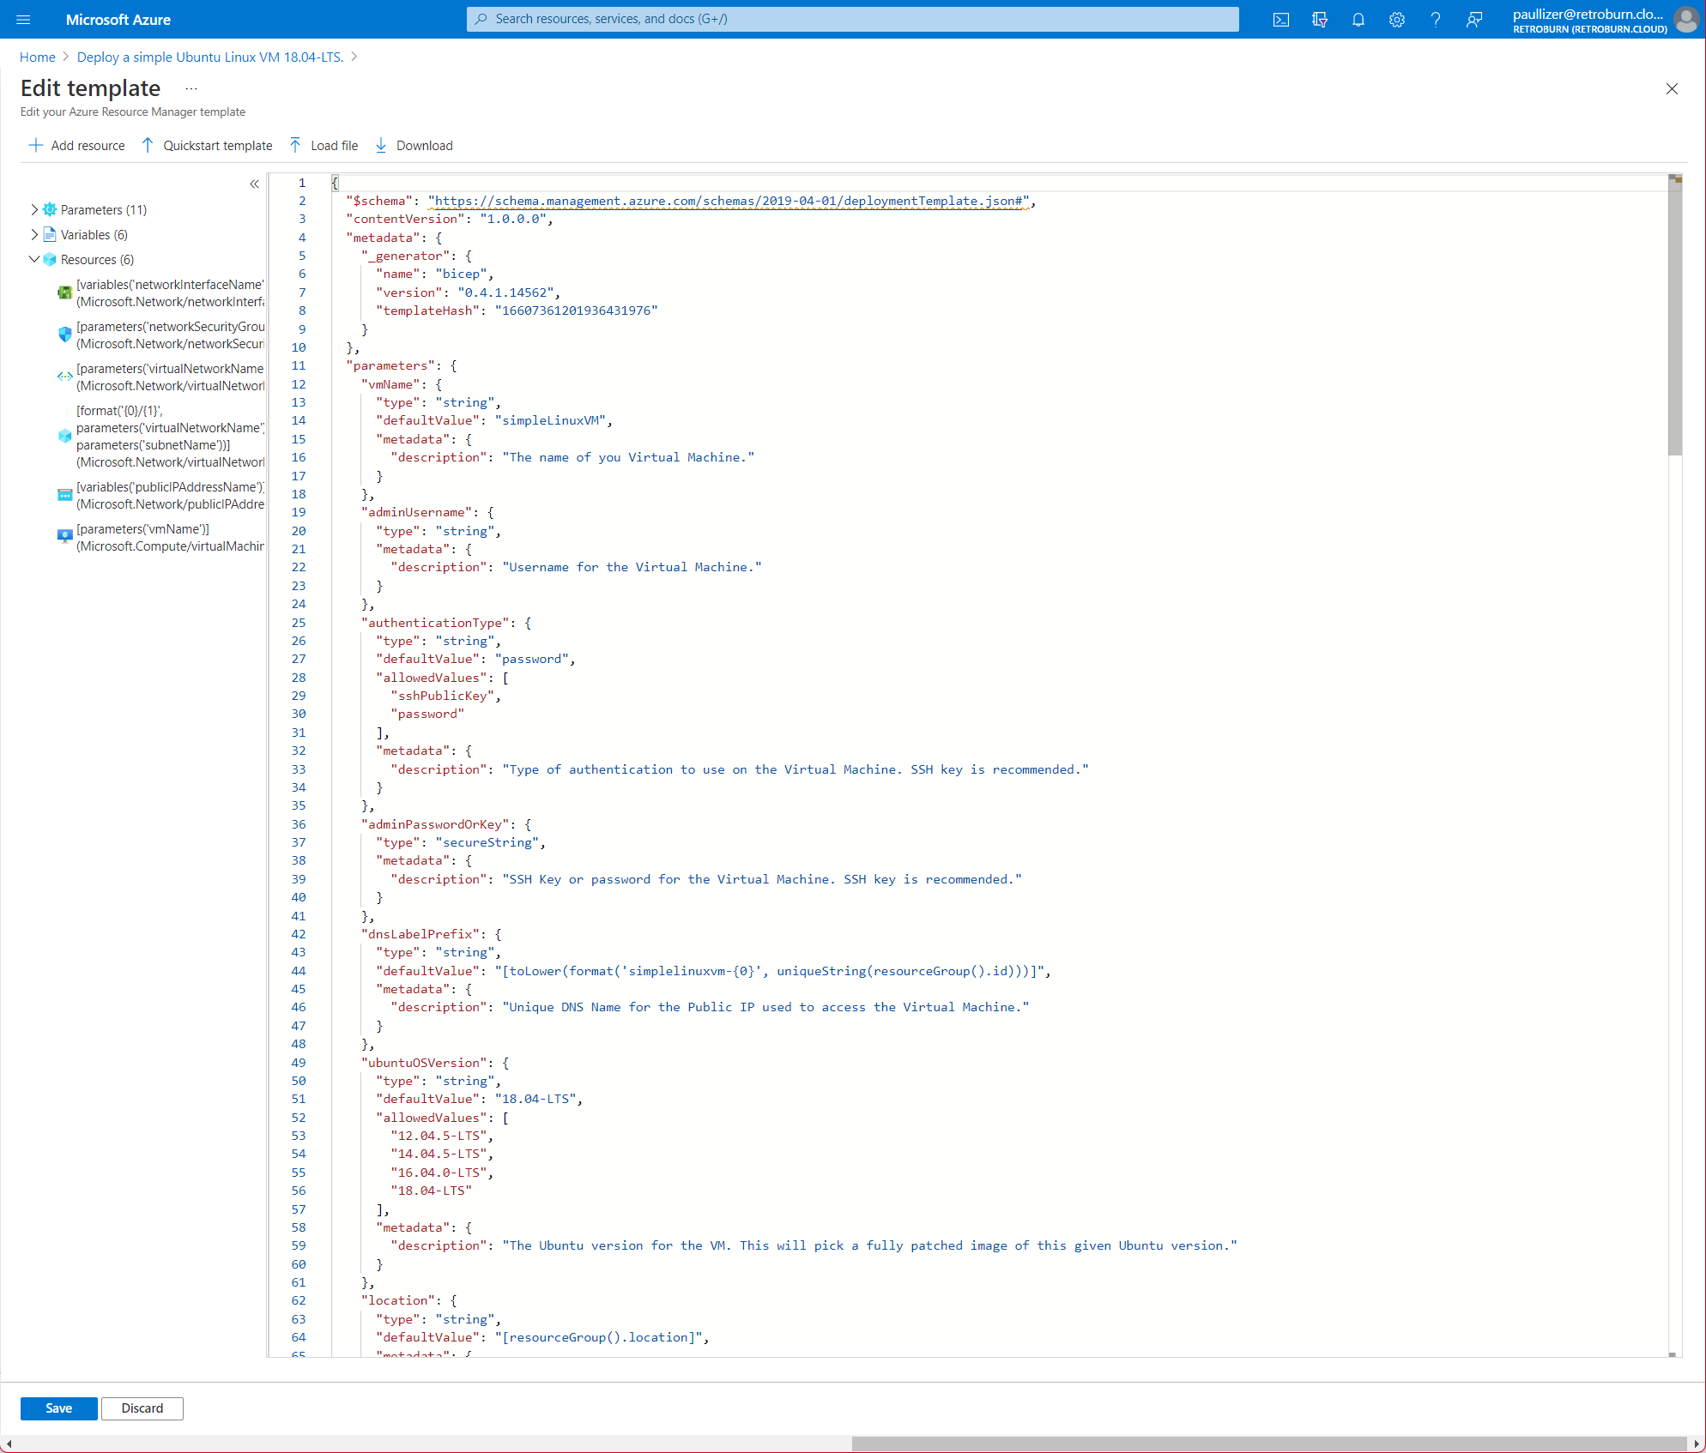
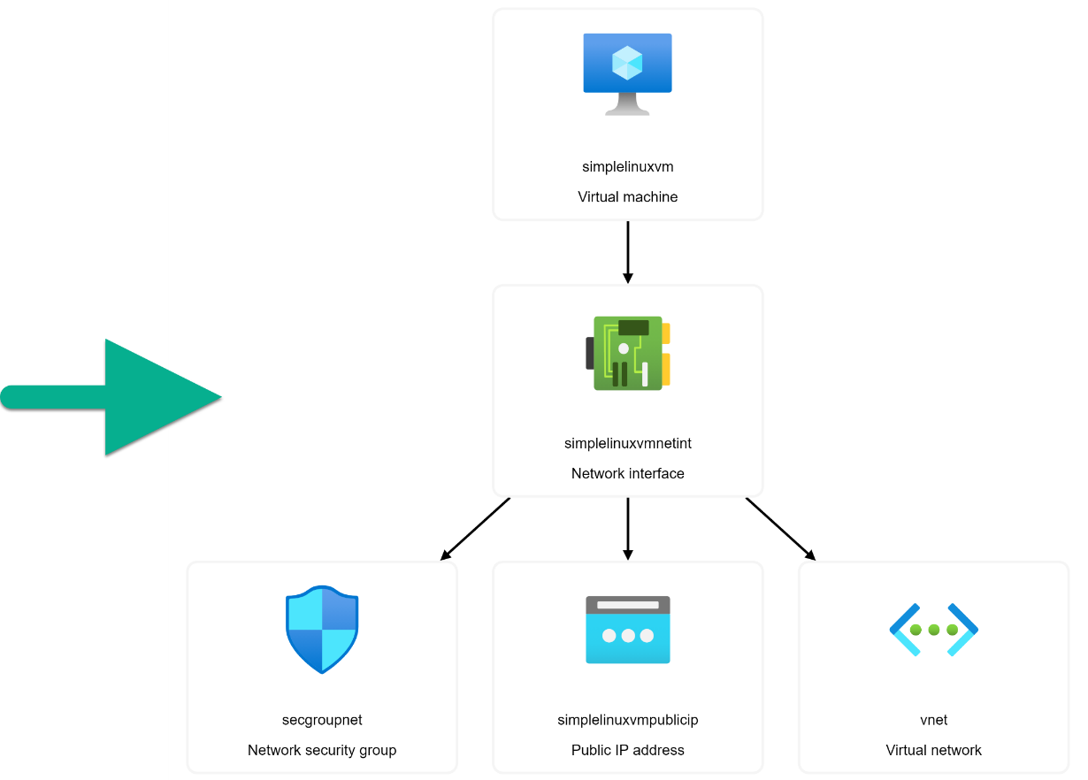
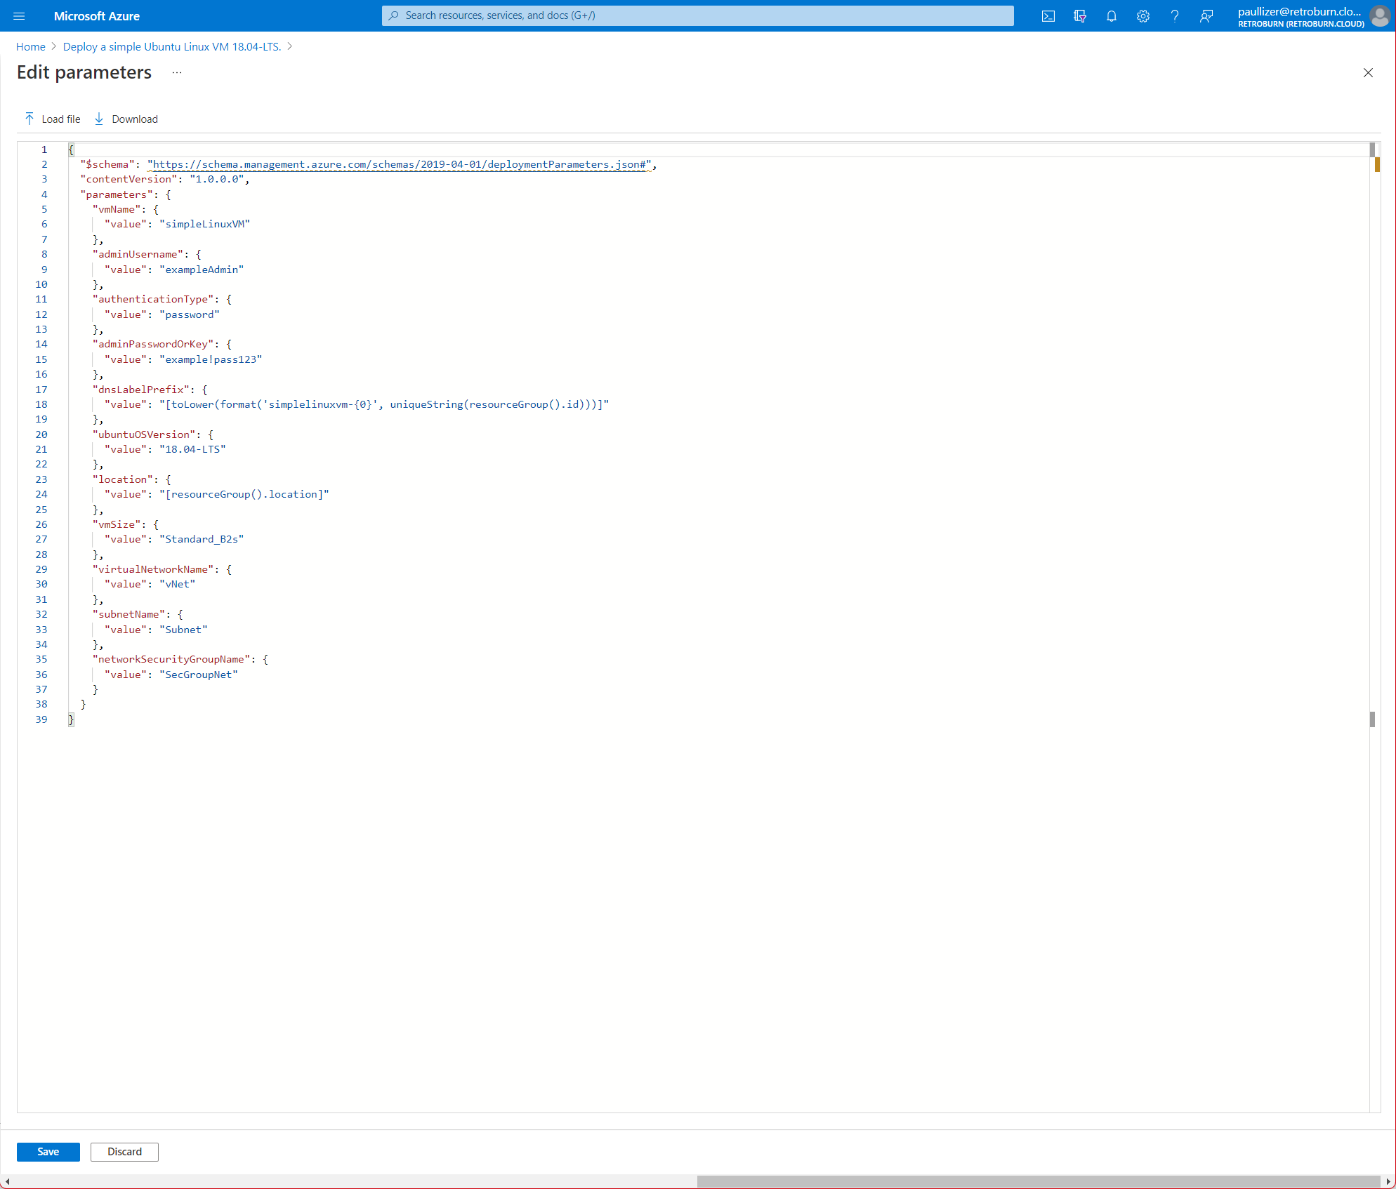

Infrastructure as Code

Slide 17
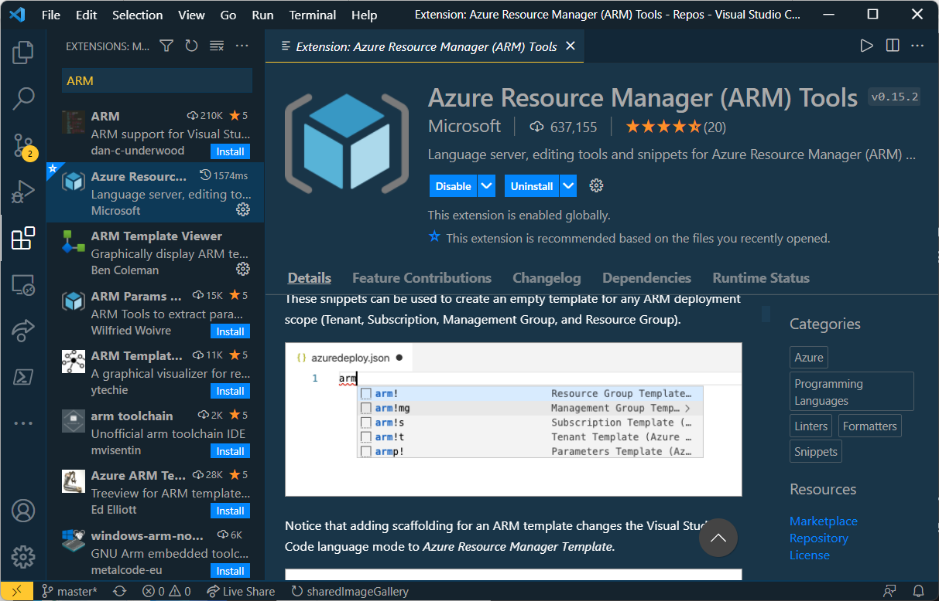
Visual Studio Code and ARM
Create template - Visual Studio Code - Azure Resource Manager | Microsoft Docs

Slide 18
Deploy VM via Portal using Shared Image Gallery
8
Create an VM from Azure Shared Image Gallery using the portal - Azure Virtual Machines | Microsoft Docs

Slide 19
Deploy SIG VM via Portal using ARM Template
8a
Deploy template - Azure portal - Azure Resource Manager | Microsoft Docs

Slide 20
Deploy SIG VM via PowerShell using ARM Template
8b
Create a VM from a generalized image - Azure Virtual Machines | Microsoft Docs

Slide 21
Additional Training
Self-pace
Deploy Azure infrastructure by using JSON ARM templates - Learn | Microsoft Docs

Slide 22
Next Steps
Test creating Azure resources via portal
Test creating Azure resources via PowerShell
Test creating Shared Image Gallery
Test creating Definitions and Images
Test deploying Virtual Machines
Resources can be deleted following creation and incur little cost
Use TAGS to simplify cleaning up resources created for testing

